Slide 1
410. Retail advertising
Titan Eye+ - A perfect match for every lifestyle

Slide 2
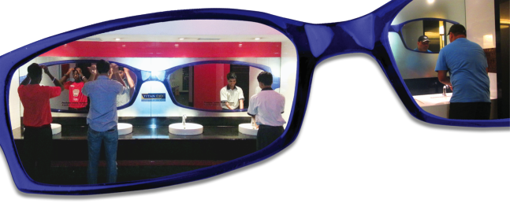

Slide 3
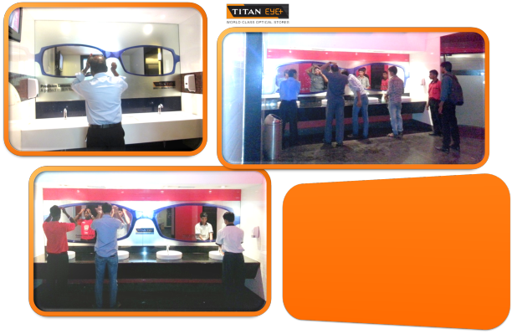
Objective
Titan wanted to promote its new range of spectacles & glasses by reaching out to its audiences using an unconventional, cost effective approach. The need was to underline their brand proposition of ‘clarity & precision’

Slide 4
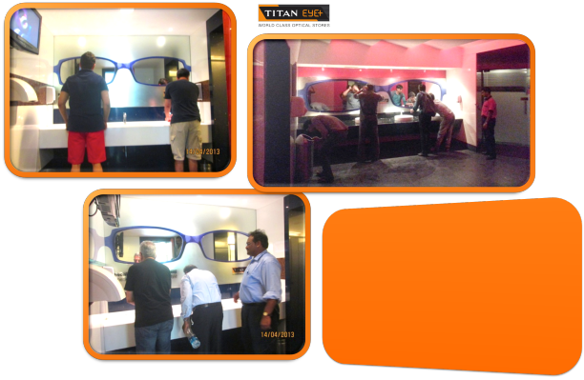
Creative Strategy
The Idea: To create a new medium of communication that has not been used before, we brainstormed and ideated and finally locked upon using Mirrors.
Keeping in mind the objectives, we created a large frame of one of the products available in the Titan Eye Care range and placed it on mirrors across the city. The entire mirror appeared foggy barring the area within the titan frame, instantly indicating ‘clarity.’ There’s nothing better than a mirror to represent clarity. Malls, Multiplexes in Mumbai & Bangalore were chosen as mediums to connect with the TG i.e. the Youth.

Slide 5
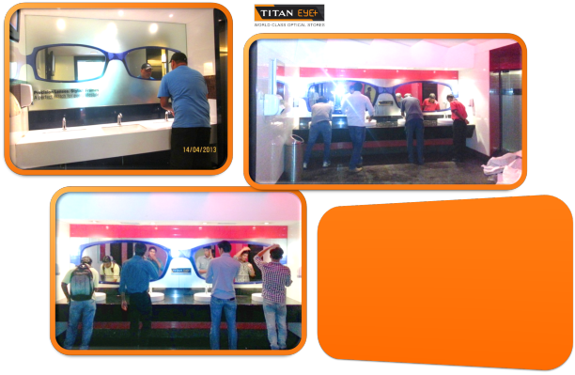
Effectiveness
The message of ‘clarity and precision’ was innovatively communicated to the right target audience. The unique campaign of using a Mirror worked well for the brand. The campaign created a lot of buzz and made the message memorable.

